Slide 1
PHYS 7703: Planetary Science
Earth: Surface and Interior
Disclaimer: Much of the material contained within these lectures is subject to
copyright and is not for distribution or use outside of this course.

Slide 2
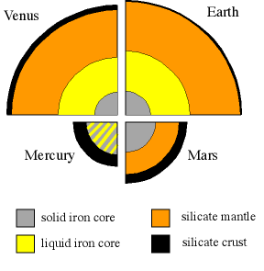
Anatomy of a Terrestrial Planet
Three Regions
Crust (Lithosphere)
Solid
Mantle
Silicates (Rock)
Can be Liquid or Solid
Core
Mainly Iron
Can be Liquid or Solid
Notes:
Terrestrial planets encompass Mercury, Venus, Earth and Mars. These planets all have similar anatomies in that they are larger differentiated bodies. Differentiation will be discussed later in this lecture, but for the meantime it can be thought of as the separation of materials by density (denser materials like iron and oxides of iron fall to the center of the body while lighter materials such as silicates “float”). Venus, Earth and Mars have similar interiors while mercury seems to be different because of its proximity to the sun and its size (this will be discussed in the Mercury portion).

Slide 3
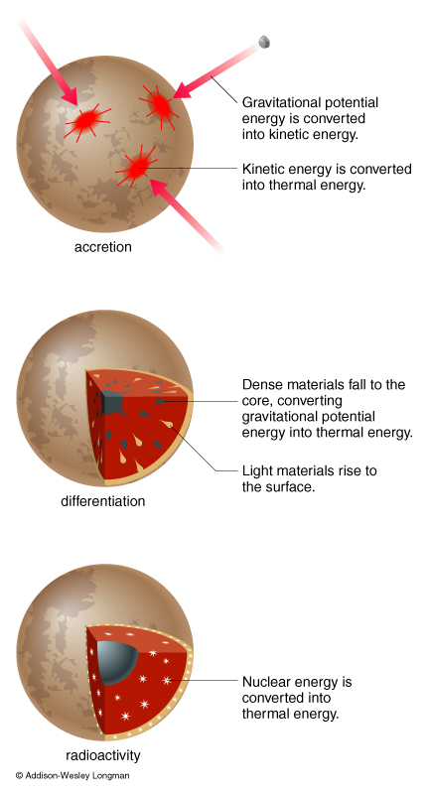
Heating a Planet
Accretion
Energy of formation
Collisional energy converted to thermal Energy
Differentiation
Interior must be hot enough to melt.
Release of potential energy by the falling dense material.
Radioactivity
Long lived radioactive elements tend to be bonded to the silicates.
Main energy source.
Notes:
Accretion: The process of forming the planet from smaller pieces. The collisional energy is converted to thermal energy thus heating the planet.
Differentiation: If the interior can melt then the denser material will fall into the center while the less dense material will “float” on the denser core. This releases the potential energy stored by the heavier material.
Radioactivity:

Slide 4
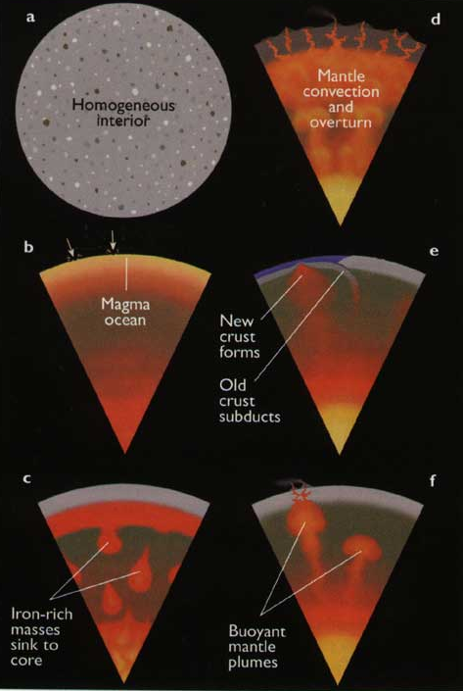
Differentiation
Gravitational separation of materials according to their density.
Occurs quickly when portions are liquid.
Rheid: Substance that is brittle over short time scales and fluid over long time scales.
Makes the fluid like deformation of rocks – called plastic flow.
Notes:
The plastic flow or rheidity of the materials making a planet allow for the gradual sinking of higher density materials through lower density materials. Example given in the book illustrates this well (pg 192) a cannonball fired at some pitch will crack the pitch while a cannonball that is placed onto a vat of pitch will eventually sink. Also a planet with a dense crustal layer overlying a lower density layer is unlikely because this layer will in general sink.

Slide 5
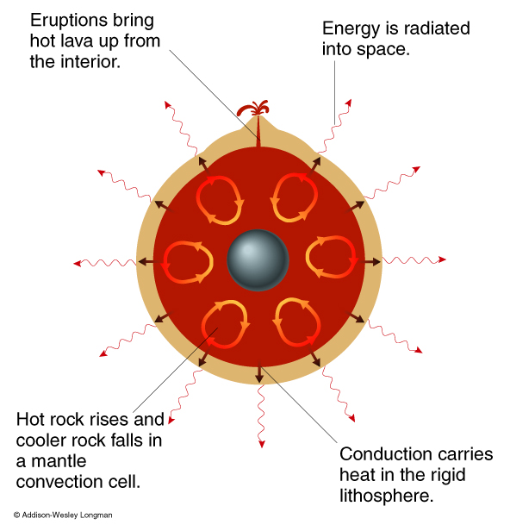
Cooling a Planet
Conduction
Heat is removed through contact transfer.
Convection
Heated from below and cooled from above.
Turning over causes release of heat.
Eruption
Radiation
Notes:
Conduction: Slow

Slide 6
Mass Density
Best Means for Finding Composition
Note the Core is a high pressure mixture of Iron, Nickel and either Sulfur or Oxygen
Mineral | Composition | Density (g/cm³)
Ice | H₂O | 0.917
Quartz | SiO₂ | 2.65
Orthoclase | KAlSi₃O₈ | 2.57
Albite | NaAlSi₃O₈ | 2.62
Anorthite | CaAlSi₂O₈ | 2.76
Olivine | (Mg, Fe)₂SiO₄ | 3.27-3.37
Augite | Ca,Mg,Fe,Al Silicate | 3.2-3.4
Pyrite | FeS₂ | 5.02
Magnetite | Fe₃O₄ | 5.18
Hematite | Fe₂O₃ | 5.26
Aluminum | Al | 2.69
Iron | Fe | 7.87
Nickel | Ni | 8.90
Copper | Cu | 8.96
Lead | Pb | 11.35
Gold | Au | 19.3
Layer | Avg Density (g/cm³)
Continental Crust | 2.7
Oceanic Crust | 2.9
Mantle | 4.5
Outer Core | 11.8
Inner Core | 16.0
Earth | 5.5
Notes:
Maybe a good time to test the student’s feel for density…for instance mention that an unknown planet has a density of 3.5 g/cm3 and suggest that it could be made of mostly iron, rock or water and get the student’s opinion on this. (Note the planet should be mostly rock with an iron core).

Slide 7
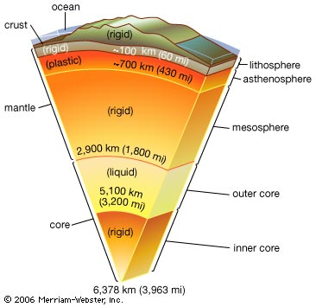
Anatomy of the Earth
Average Density: 5.5 g/cm³
Solid Inner Core composed of Iron, Nickel and Sulfur.
Liquid Outer Core composed of liquid iron and sulfur.
Rigid Mantle composed of silicate materials.
Rigid Crust.
Notes:
These are the general properties of the Earth. As discussed in the previous slide the Earth is believed to be broken up into three distinct regions: the core which consists of the inner solid core and the outer liquid core, the rigid mantle which is broken up into the mesosphere the asthenosphere and the lithosphere and the rigid crust.

Slide 8
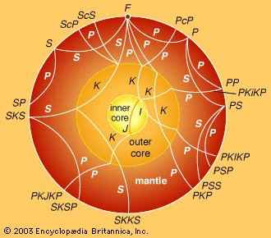
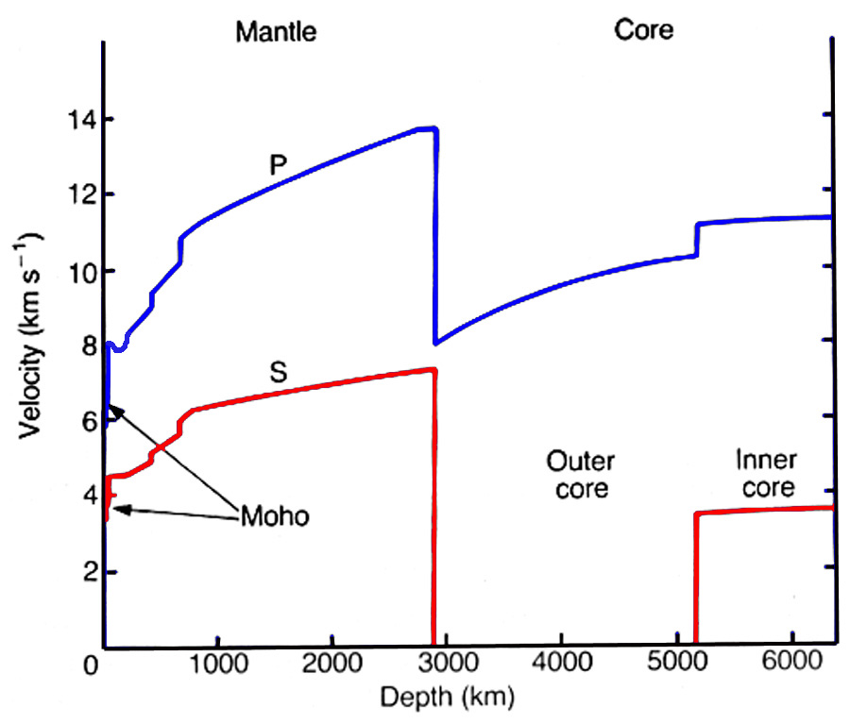
How Do We Know?
Seismology - Earthquake Measurements.
Primary or P waves
Compressional waves
Secondary or S waves
Shear waves
They travel at different velocities depending on the material.
Notes:
Since we currently don’t have the technology or the will to travel to the center of the Earth we must utilize the data available to determine the interior structure. To do this we use seismology, especially the comparisons of seismological data from several stations. Since P and S waves travel at different velocities through different materials, the timing of seismic events (earthquakes, volcanic activity, human made activity, etc…) can be compared to develop a model of the structure of the layers of the Earth. This plus reasonable guesses as to the material involved gives us our current view of the Earth’s interior.

Slide 9
SURFACE PROCESSES
Impacts
Tectonics
Volcanism
Weathering
Erosion

Slide 10
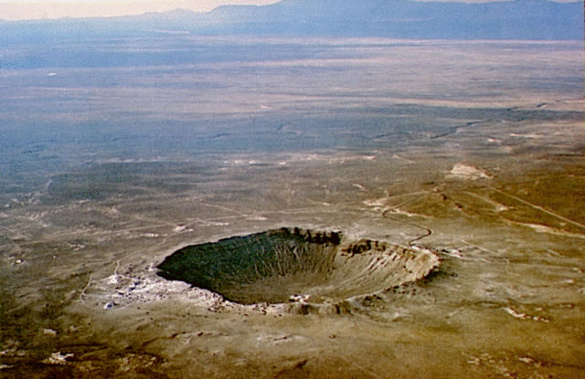
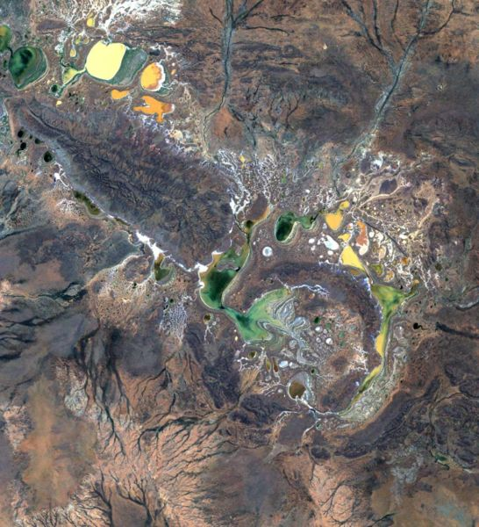
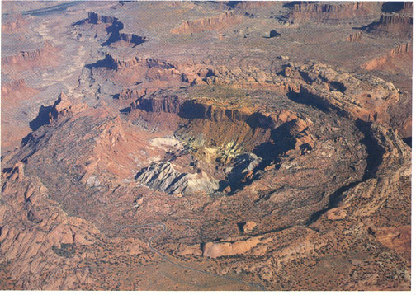
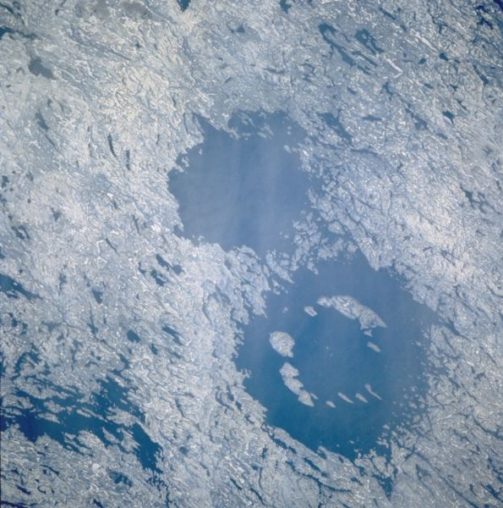
Impact Cratering
Meteor Crater, Arizona
Shoemaker Crater, Australia
Upheval Dome, Utah
Clearwater Lakes, Quebec

Slide 11
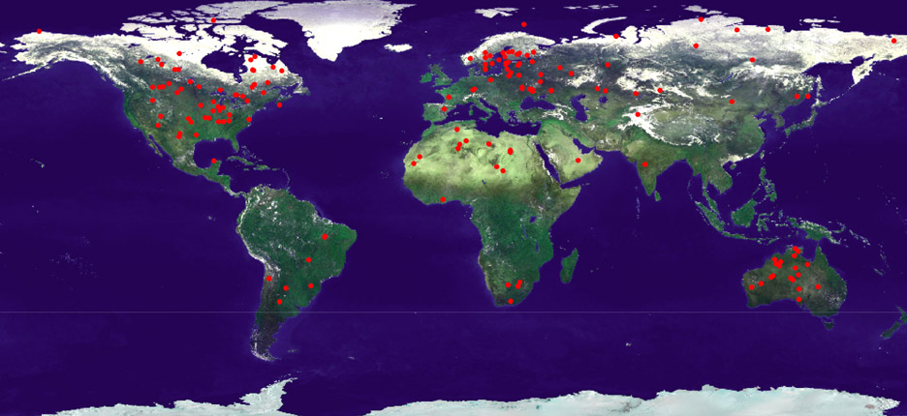
Identified Impact Craters
http://www.lpl.arizona.edu/SIC/impact_cratering/World_Craters_Web/intromap.html
Notes:
There are ~200 identified impact craters on Earth. Note the distribution of these can be influenced by human activities, access to the sites and vegitation as well as water in general (erosion).

Slide 12
Tectonics
The study of deformation and structure of the crust
Faulting
Folding
Tectonics is important for understanding
The geologic history of a planet
Weathering and erosion on a planet’s surface
Movement and emplacement of economically vital resources
Oil and gas reserves
Groundwater
Precious metals/gems
Notes:
12

Slide 13
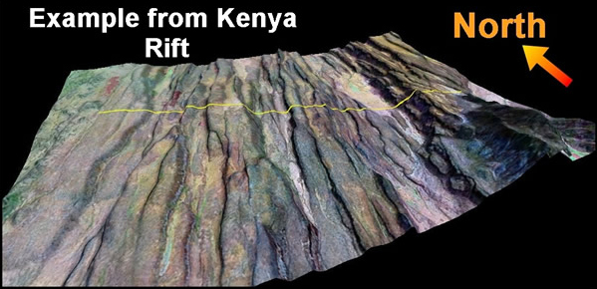
Tectonics
There are three main types of tectonic regimes
Extensional
Contractional (thrust)
Strike-slip
Notes:
13

Slide 14
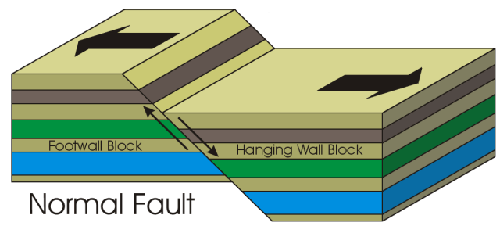
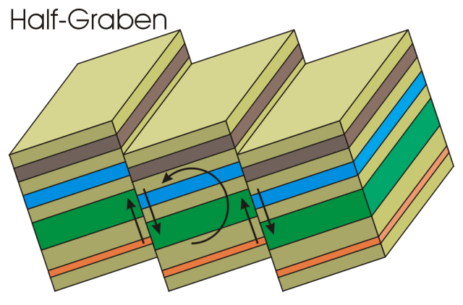
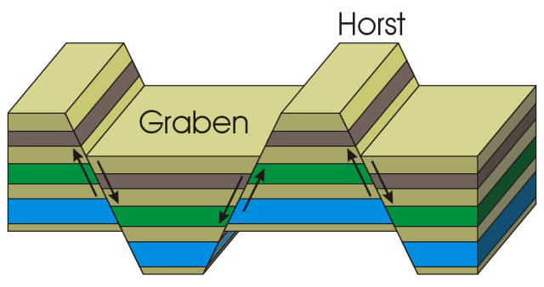
Extensional Tectonics
Areas of the crust that have been stretched (extended)
Characterized by normal faults either in horst/graben formation or imbricate faulting
Notes:
14

Slide 15
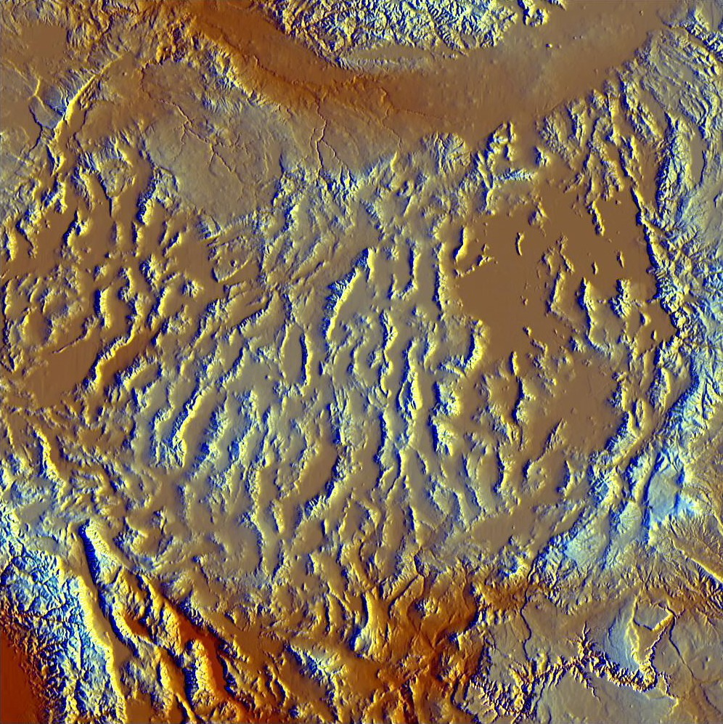
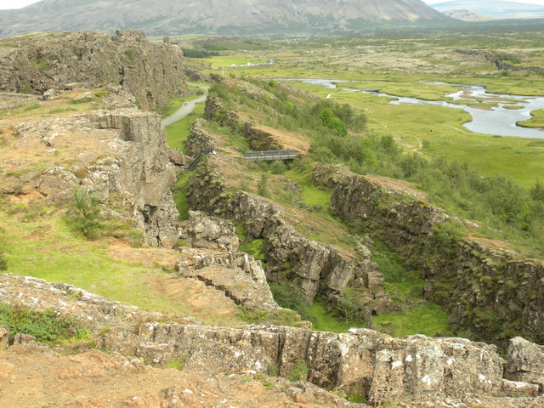
Extensional Tectonics
Basin and Range, U.S.
Þingvellir, Iceland
Notes:
15

Slide 16
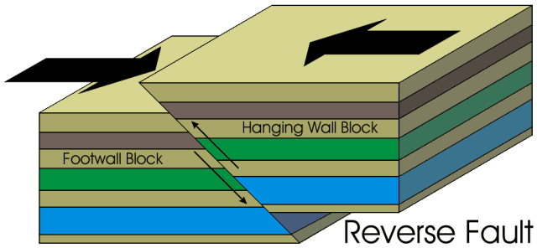
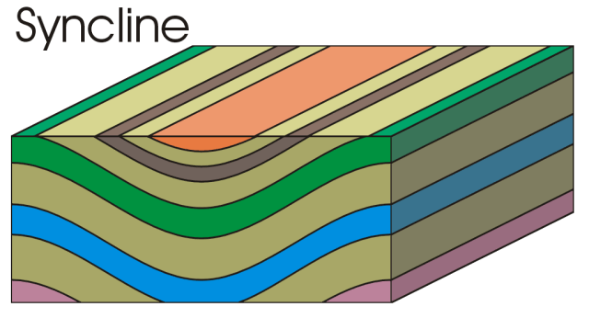
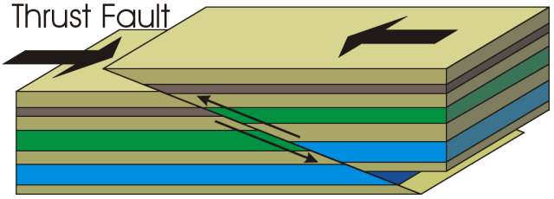
Contractional Tectonics
Areas of the crust that have been shortened (contracted)
Characterized by folding and reverse/thrust faulting
Notes:
16

Slide 17
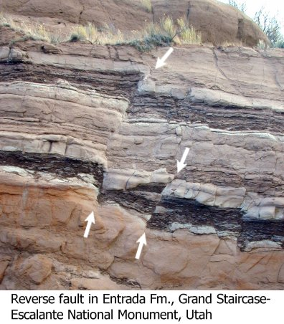
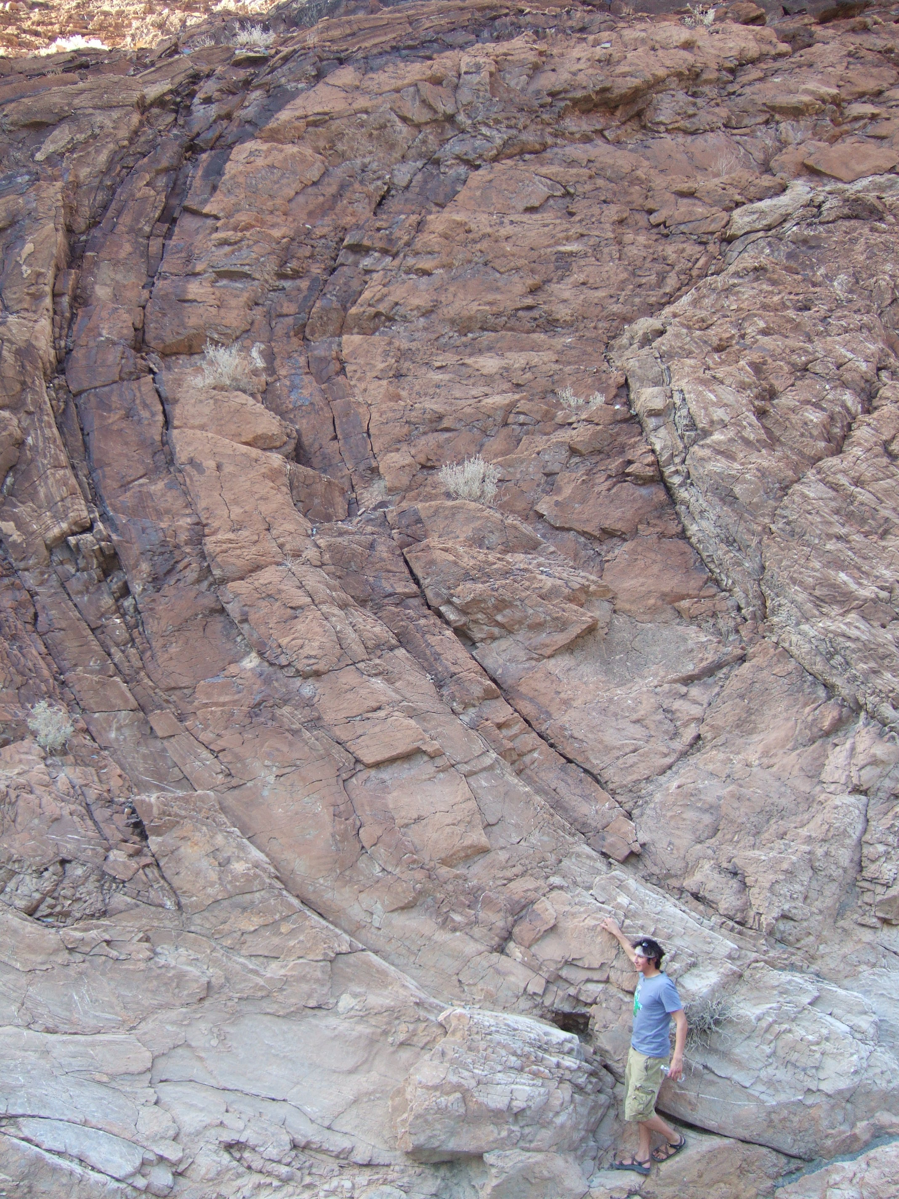
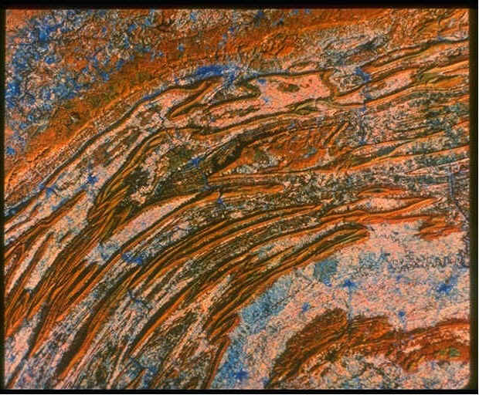
Contractional Tectonics
Death Valley, CA
Appalachians from space
Notes:
17

Slide 18
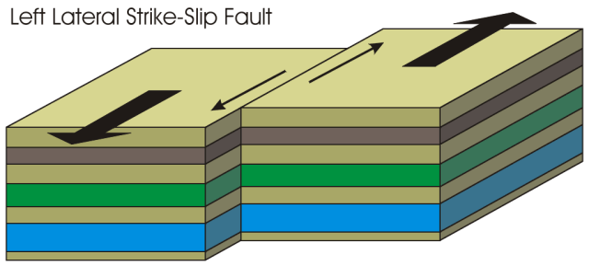
Strike-slip Tectonics
Areas of the crust that are moving past each other (lateral displacement)
Often seen at plate boundaries
Notes:
18

Slide 19
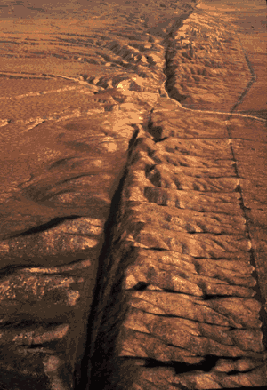
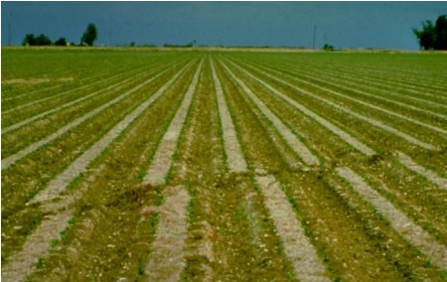
Strike-slip Tectonics
San Andreas fault, CA
Notes:
19

Slide 20
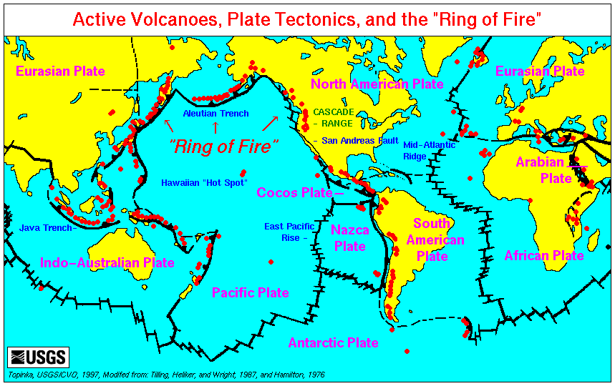
Why does Earth have plate tectonics?
Notes:
20

Slide 21
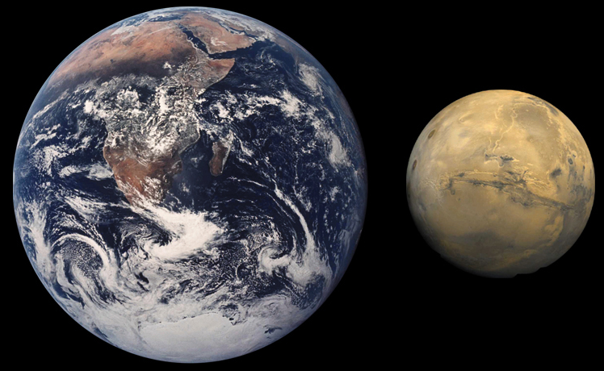
Why does Earth have plate tectonics?
Interior Heat
Earth is roughly twice the size of Mars
It Surface/Volume ratio is lower and cooled slower
Notes:
21

Slide 22
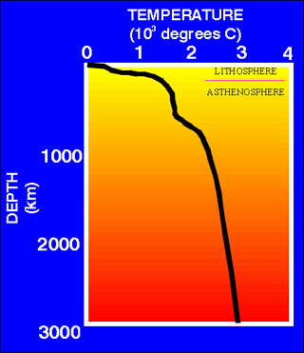
Why does Earth have plate tectonics?
Heat Gradient
On Earth, the lithosphere has an average temperature gradient of ~30C°/km
On Venus, surface temperature is ~500°C
Small temperature contrasts (and subsequent density contrasts) may produce less vigorous mantle convection
Notes:
22

Slide 23
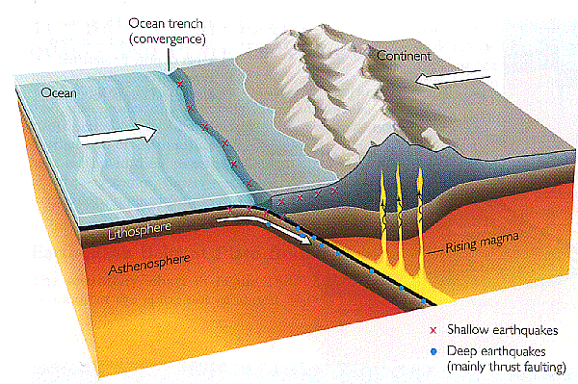
Why does Earth have plate tectonics?
The Role of Water
Reduces the coefficient of friction, (e.g., fault zones)
Facilitates ductile shear zones, creating zones of weakness
Earth has water in all phases, as well as hydrated minerals. The moon is relatively water poor.
Notes:
23

Slide 24
Why does Earth have plate tectonics?
The Role of Water
As a volatile, water lowers the melting temperature of many rocks
Notes:
24

Slide 25
Why does Earth have plate tectonics?
Composition
Earth has two kinds of crust: Continental and Oceanic
The density contrasts between the two crustal types facilitates subduction
Notes:
25

Slide 26
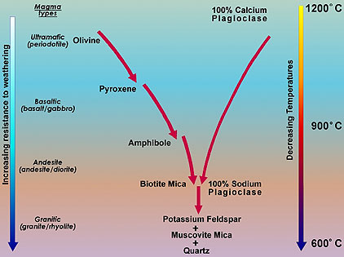
Why does Earth have plate tectonics?
Composition
Why does Earth have different types of crust?
Oceanic crust is mafic: more Fe/Mg rich; crystallizes out of the melt first
Continental crust evolves from the remaining magma composition and is felsic; Higher Si, lower FeMg content
Notes:
26

Slide 27
Volcanism
Volcanism occurs from three major processes
Extensional rift zones
Subduction zones
Hot spots

Slide 28
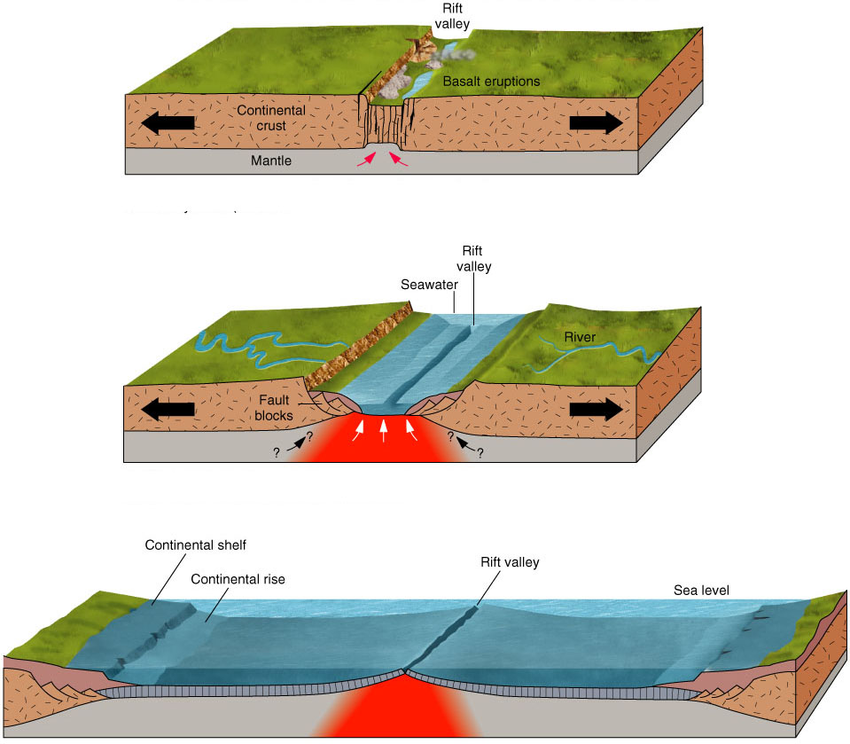
Extensional Rift Zones
As crust is extended, it gets thinner
Tectonic thinning means less overburden pressure
Less pressure leads to decompression melting
Typically basaltic in composition
Notes:
28

Slide 29
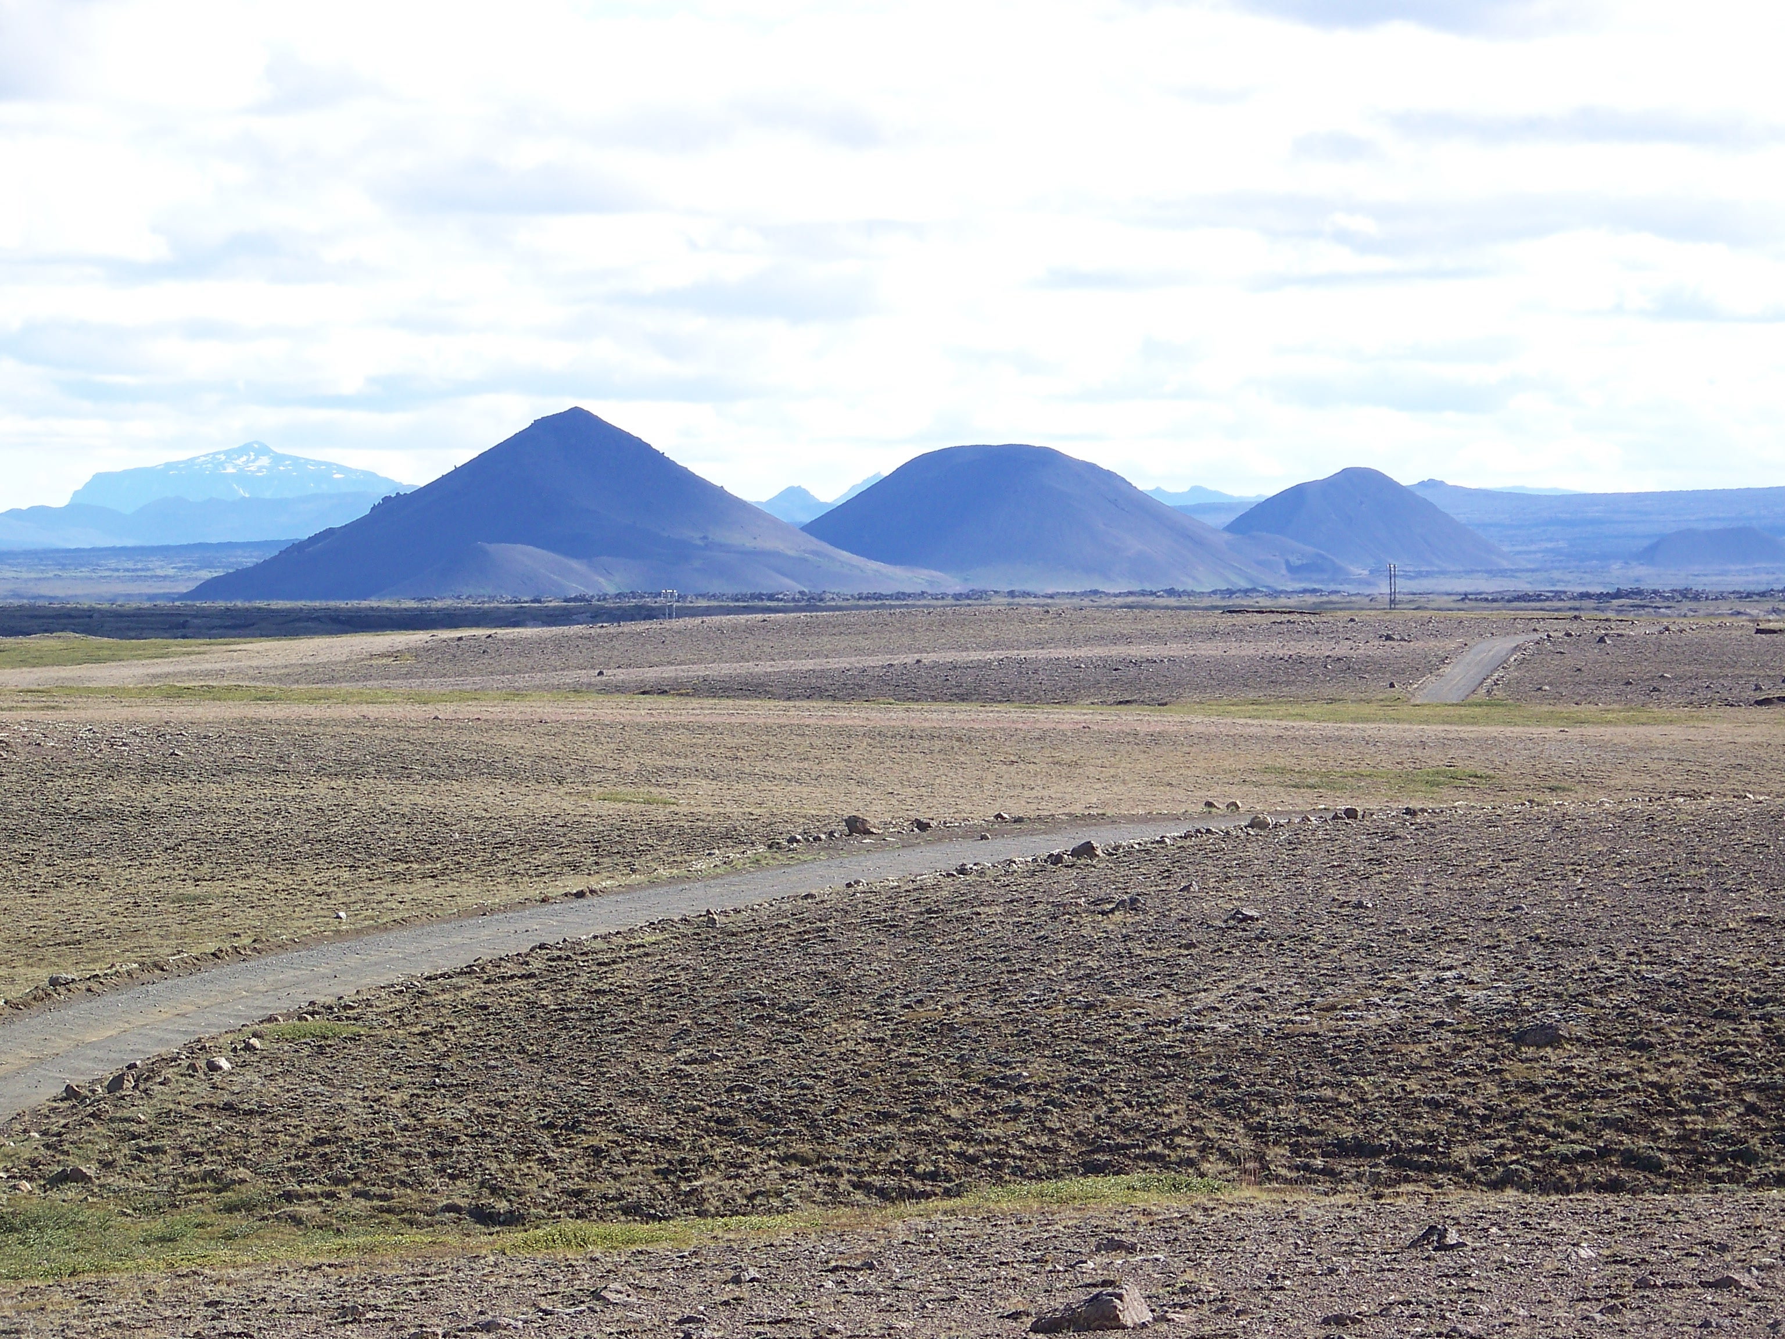
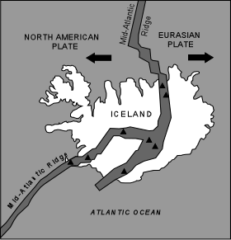
Extensional Rift Zones
Iceland
Mid-ocean ridge between North American and Eurasian plates
Notes:
29

Slide 30
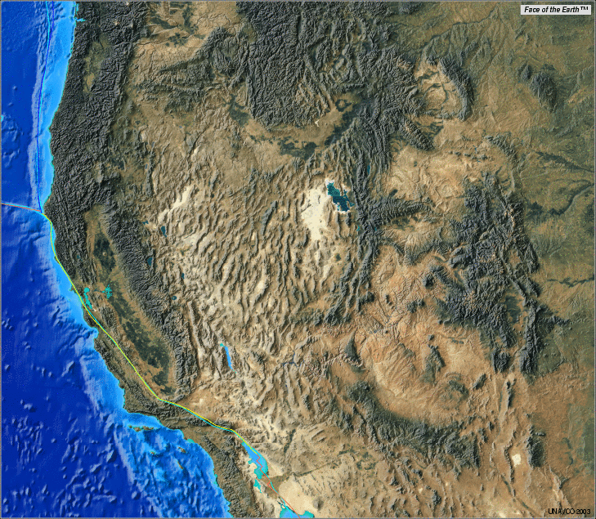
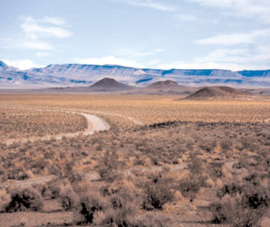
Extensional Rift Zones
Basin and Range of North America
Southwest U.S. and northern Mexico
Notes:
30

Slide 31
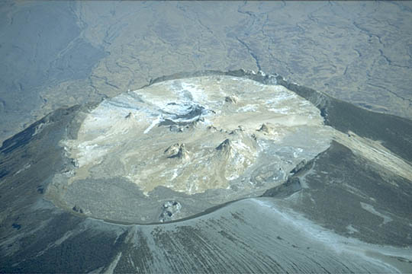
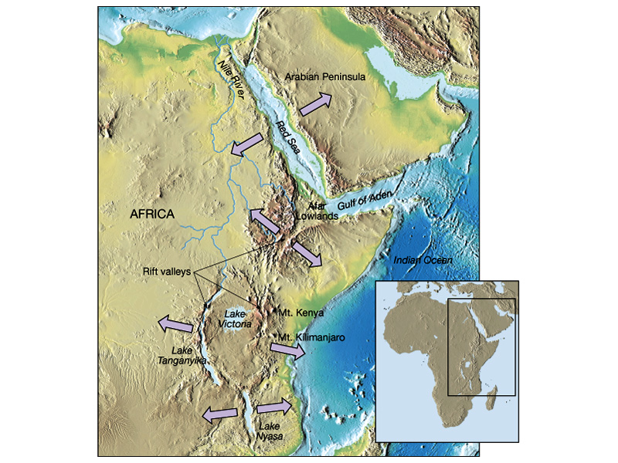
Extensional Rift Zones
East African Rift Zone
Notes:
31

Slide 32
Subduction Zones
In areas where two plates collide, the denser oceanic plate will subduct under the continental crust
Volatiles (typically H₂O) in the oceanic crust will rise through the overlying crust
The volatiles lower the melting temperature of the crust, causing melt
Magmas are usually more viscous due to the higher silica content
Notes:
32

Slide 33
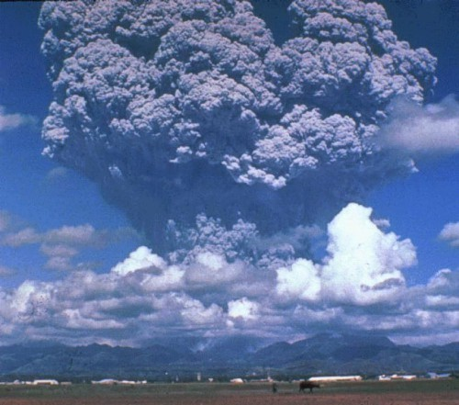
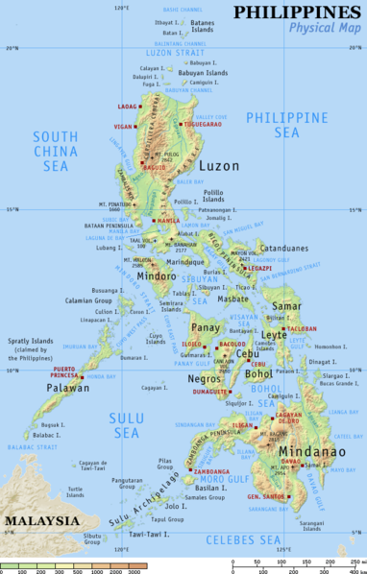
Subduction Zones
The Philippines
Mt. Pinatubo
Notes:
33

Slide 34
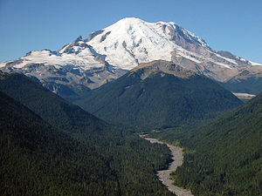
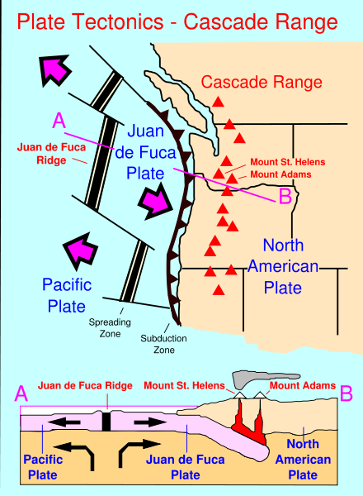
Subduction Zones
The Cascade Range, U.S.
Mt. Rainier
Notes:
34

Slide 35
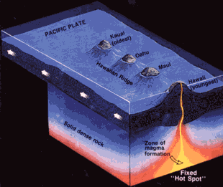
Hot Spots
Narrow mantle plumes
Disagreement as to whether plumes form at the core-mantle boundary or from upper mantle convection
Hot spots under oceanic crust will tend to be basaltic
Think fluid lava flows
Hot spots under continental crust will tend to be rhyolitic
Think explosive eruptions
Notes:
35

Slide 36
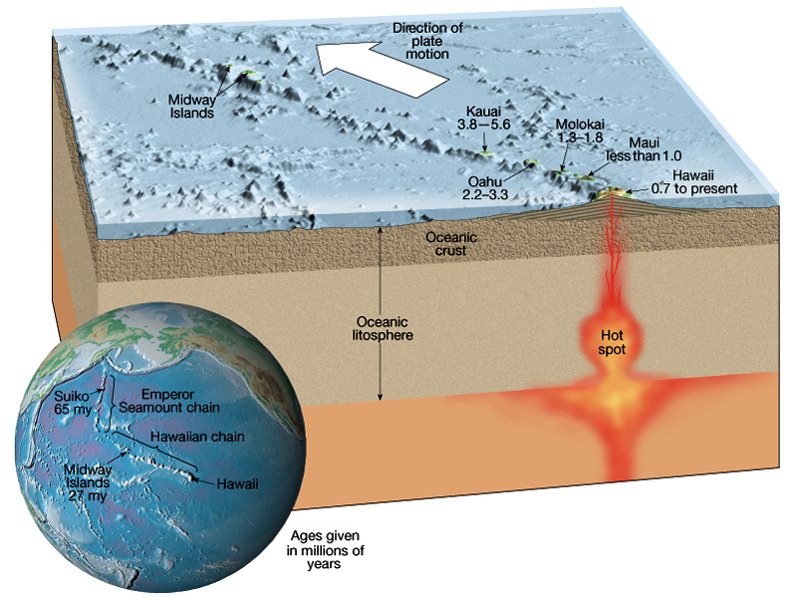
Hot Spots
Hot spots under oceanic crust
Hawaiian Islands
As the Pacific plate moves over this hot spot, new volcanoes are created
This chain started ~70 million years ago near Kamchatka, Russia
Notes:
36

Slide 37
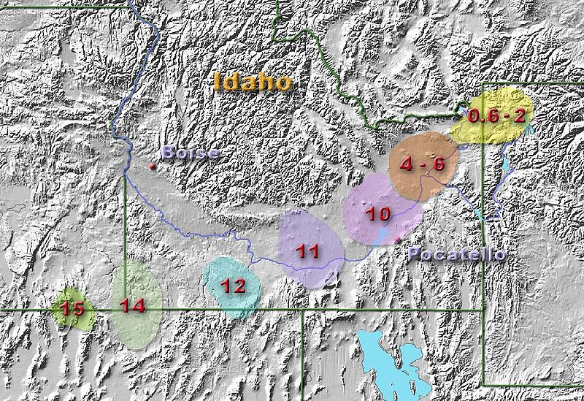
Hot Spots
Hot spots under continental crust
Yellowstone
As the North American plate moves over this hot spot, violent eruptions and massive lava flows have occurred
This chain started ~17 million years ago near the border of Nevada and Oregon
Notes:
37

Slide 38
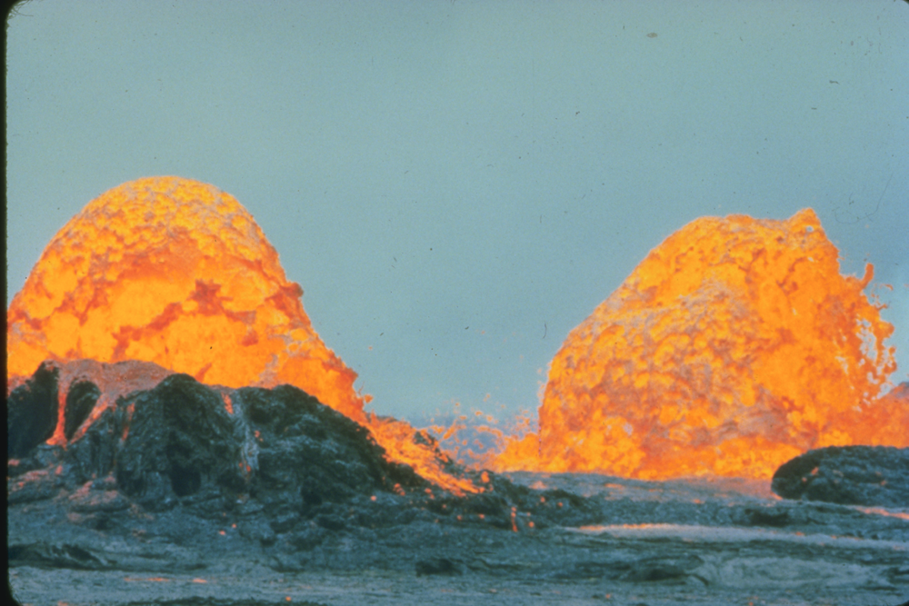
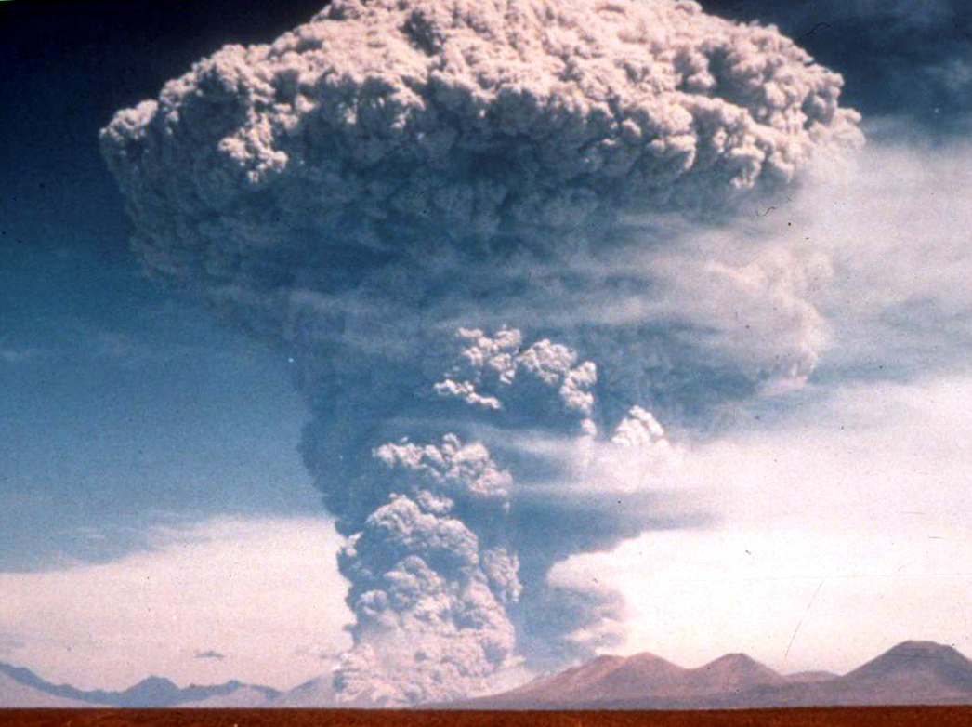
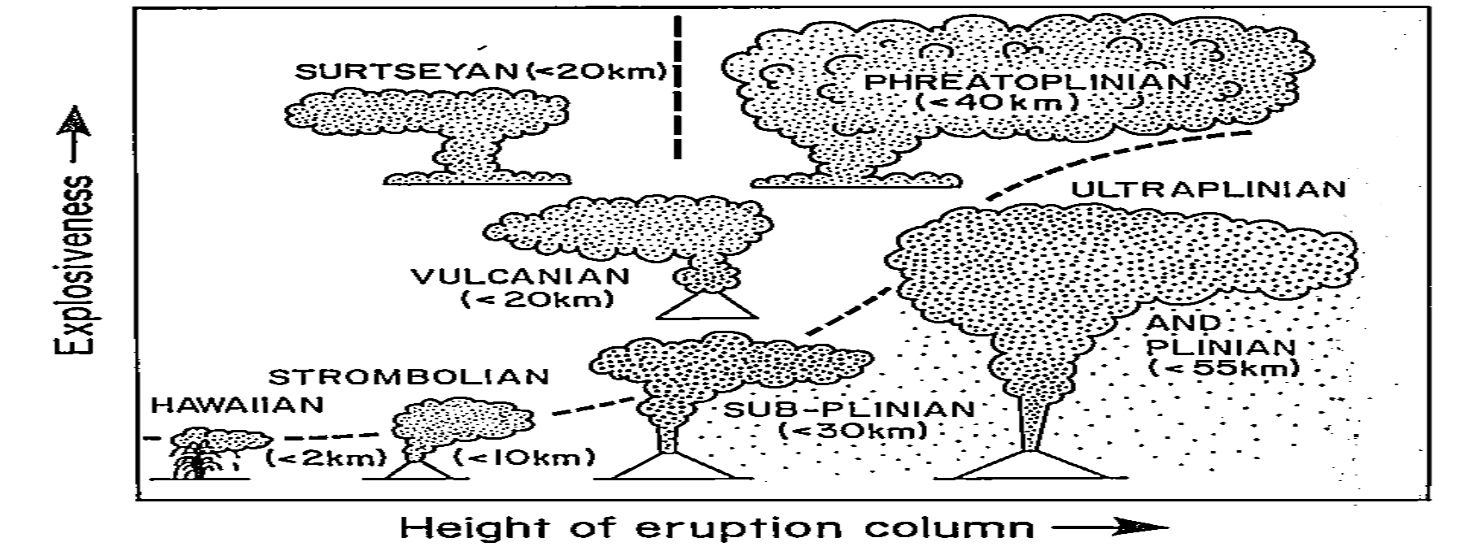
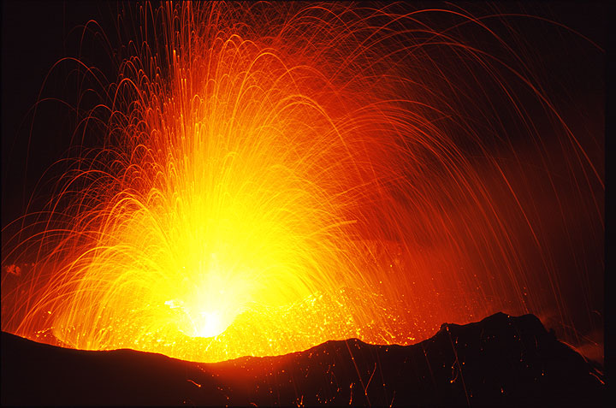
Types of volcanoes
Cas and Wright, 1988

Slide 39
Volcanic gases
H2O
SO2
CO2
H2S
H2
NO2
CO
HCl
HF
BrO

Slide 40

Case example: Mt. Pinatubo
The HCl levels found in the stratosphere from Pinatubo were not exceptionally high
Most HCl washed out in the troposphere (McCormick, 1995)
A significant amount of Bromine was found in the Mt. Pinatubo eruption – comparable to the total annual influx into the stratosphere from all other natural and anthropogenic sources combined. (Bureau et al., 2000)

Slide 41













Case example: Mt. Pinatubo
NASA/Goddard Space Flight Center Scientific Visualization Studio

Slide 42



Weathering processes
Weathering: The breaking down of rocks and soils in situ through physical or chemical means
Physical Weathering
Thermal expansion
Frost shattering
Pressure release
Thermal expansion
Enchanted Rock, TX
Pressure release
Alabama Hills, CA
Frost shattering

Slide 43



Weathering processes
Weathering: The breaking down of rocks and soils in situ through physical or chemical means
Chemical Weathering
Dissolution (carbonation, sulfuric acid)
Hydration
Oxidation
Dissolution
Hydrated gypsum
Oxidation
Mexico
Ayer’s Rock, Australia

Slide 44



Erosional processes
Erosion: The removal of soil and rock
Irtysh river, Russia
Water (Fluvial)
Gully formation
Streams and rivers
Coastline
Gullies
Big Island, Hawaii
Coastline erosion
Big Island, Hawaii

Slide 45


Erosional processes
Erosion: The removal of soil and rock
Ice (Glacial)
U-shaped valleys
Moraines
Glacial erosion
Iceland
Glacial moraines

Slide 46



Erosional processes
Erosion: The removal of soil and rock
Wind (Eolian)
Cross bedding
Saudia Arabia
Death Valley, CA

Slide 47


Erosional processes
Erosion: The removal of soil and rock
Bryce Canyon, UT
Wind (Eolian)
Yardangs

